Slide 1
Lecture 4 – Objects and Classes
Programming
Principles and Practice Using C++
Shengfa Wang
sfwang@dlut.edu.cn

Slide 2
The This Pointer
The Problem: “ Inside of a class you have access to all of the private data, but how do you access the object itself like a client?”
Each object maintains a pointer to itself which is called the “this” pointer.
Each object can determine it’s own address by using the “this” keyword.
Many member functions of a class in C++ require no arguments because of the use of the implicit pointer “this”. Very handy to use this which avoids the overhead of passing parameters but still enforces the rules of good sound software engineering by using the appropriate class functions.

Slide 3
The this Pointer
Use only in non-static member function
such as, copy assignment, return *this
The same name parameters
such as, void setName(string name) { this->name=name; }

Slide 4
Program for Implementation
#include<iostream>
using namespace std;
class Hannah{
public:
Hannah(int);
void printanything();
private:
int h;
};
Hannah::Hannah(int num):h(num) { }
void Hannah::printanything(){
cout<<"h="<<h<<endl;
cout<<"this->h="<<this->h<<endl;
cout<<"(*this).h="<<(*this).h<<endl;
}
int main(){
Hannah ho(23);
ho.printanything();
return 0;
}

Slide 5
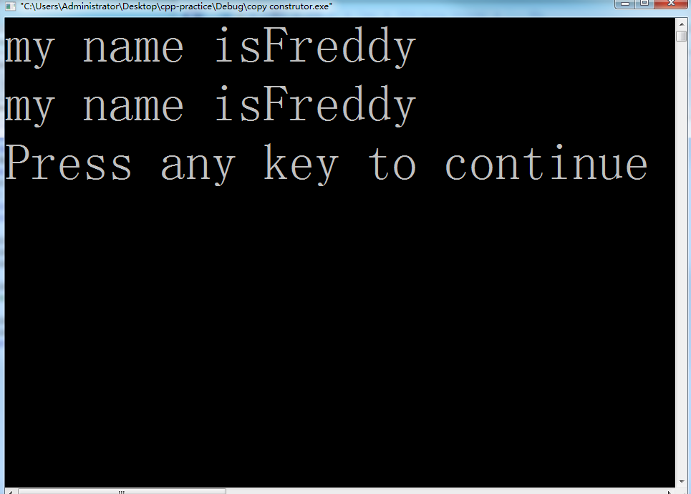
#include <iostream>
#include<string>
using namespace std;
class Animal{
private:
string name;
public:
void setName(string name) { this->name=name; }
void speak() { cout<<"my name is"<<name<<endl; }
};
int main() {
Animal animal1;
animal1.setName("Freddy");
Animal animal2=animal1;
animal1.speak();
animal2.speak();
return 0;
}

Slide 6
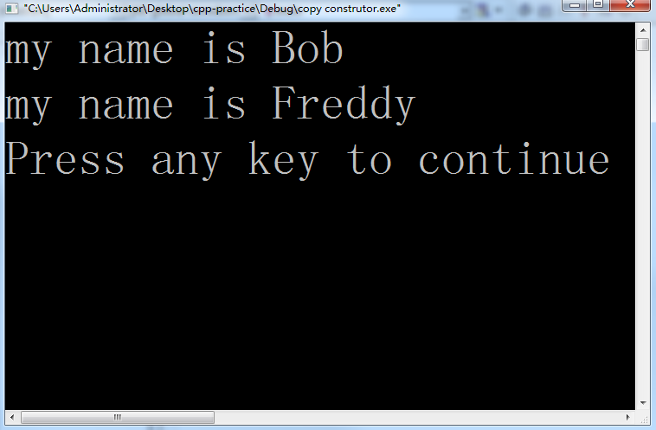
#include <iostream>
#include<string>
using namespace std;
class Animal{
private:
string name;
public:
void setName(string name) { this->name=name; }
void speak() { cout<<"my name is "<<name<<endl; }
};
int main() {
Animal animal1;
animal1.setName("Freddy");
Animal animal2=animal1;
animal1.speak();
animal2.speak();
return 0;
}
animal1.setName("Bob");

Slide 7
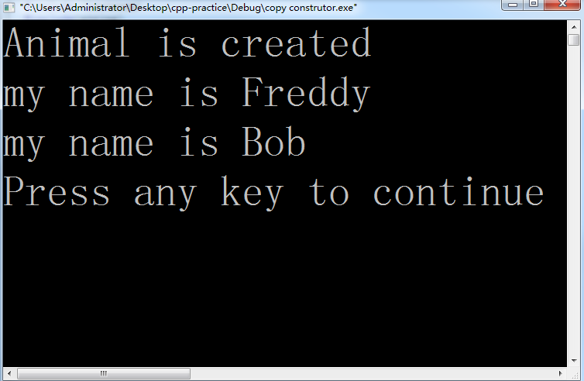
Why can’t we get the second constructor?
#include <iostream>
#include<string>
using namespace std;
class Animal{
private:
string name;
public:
Animal (){ cout<<"Animal is created"<<endl;}
void setName(string name) { this->name=name; }
void speak() { cout<<"my name is "<<name<<endl; }
};
int main() {
Animal animal1;
animal1.setName("Freddy");
Animal animal2=animal1;
animal2.setName("Bob");
animal1.speak();
animal2.speak();
return 0;
}
Why can’t we get the second constructor?

Slide 8
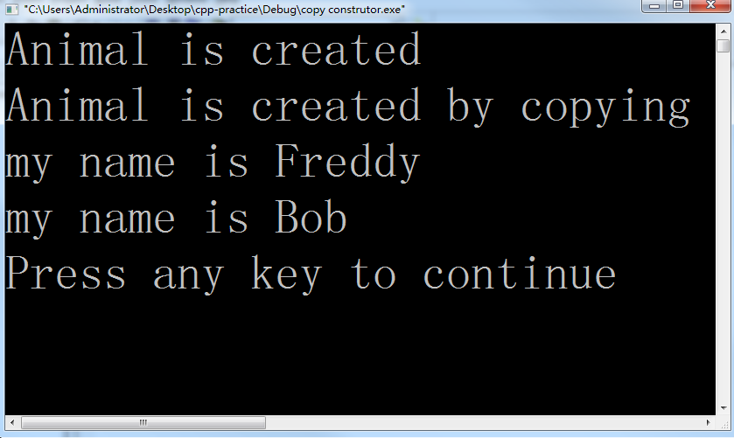
#include <iostream>
#include<string>
using namespace std;
class Animal{
private:
string name;
public:
Animal (){ cout<<"Animal is created"<<endl;}
Animal (Animal& another){ cout<<"Animal is created by copying"<<endl;}
void setName(string name) { this->name=name; }
void speak() { cout<<"my name is "<<name<<endl; }
};
int main() {
Animal animal1;
animal1.setName("Freddy");
Animal animal2=animal1;
animal2.setName("Bob");
animal1.speak();
animal2.speak();
return 0;
}

Slide 9
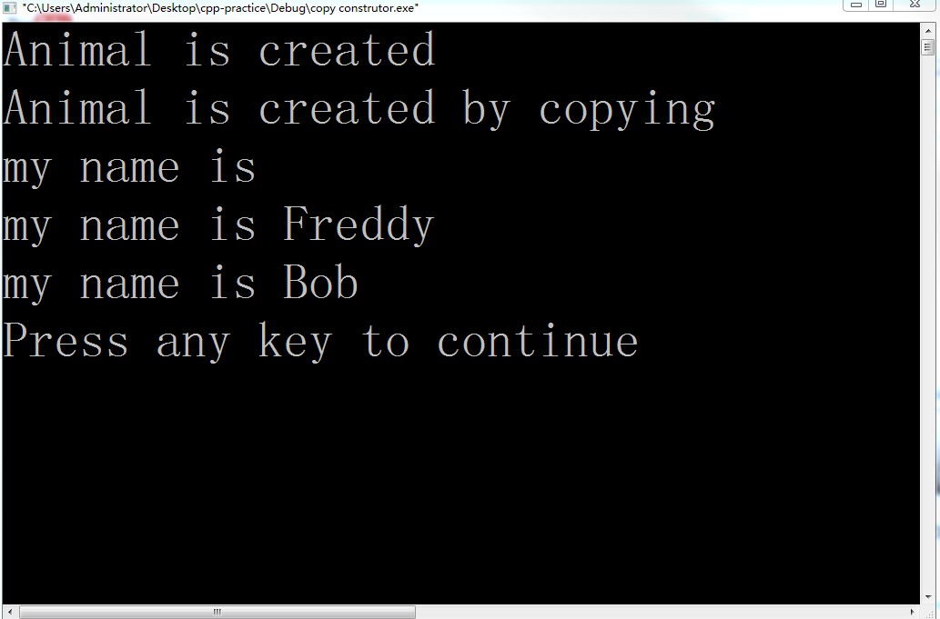
Why is it blanked out
#include <iostream>
#include<string>
using namespace std;
class Animal{
private:
string name;
public:
Animal (){ cout<<"Animal is created"<<endl;}
Animal (Animal& another){ cout<<"Animal is created by copying"<<endl;}
void setName(string name) { this->name=name; }
void speak() { cout<<"my name is "<<name<<endl; }
};
int main() {
Animal animal1;
animal1.setName("Freddy");
Animal animal2=animal1;
animal2.speak();
animal2.setName("Bob");
animal1.speak();
animal2.speak();
return 0;
}
Why is it blanked out?

Slide 10
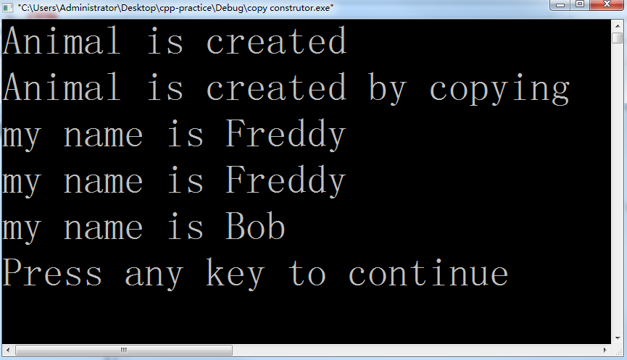
#include <iostream>
#include<string>
using namespace std;
class Animal{
private:
string name;
public:
Animal (){ cout<<"Animal is created"<<endl;}
Animal (Animal& another){
name=another.name;
cout<<"Animal is created by copying"<<endl;}
void setName(string name) { this->name=name; }
void speak() { cout<<"my name is "<<name<<endl; }
};
int main() {
Animal animal1;
animal1.setName("Freddy");
Animal animal2=animal1;
animal2.speak();
animal2.setName("Bob");
animal1.speak();
animal2.speak();
return 0;
}

Slide 11
Animal (Animal& another){
name=another.name;
cout<<"Animal is created by copying"<<endl;
}
Animal (Animal& another):name(another.name){ cout<<"Animal is created by copying"<<endl;}

Slide 12
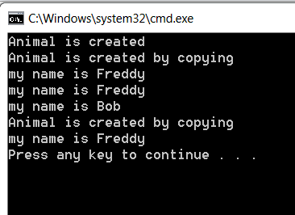
#include <iostream>
#include<string>
using namespace std;
class Animal{
private:
string name;
public:
Animal (){ cout<<"Animal is created"<<endl;}
Animal (Animal& another):name(another.name){ cout<<"Animal is created by copying"<<endl;}
void setName(string name) { this->name=name; }
void speak() { cout<<"my name is "<<name<<endl; }
};
int main() {
Animal animal1;
animal1.setName("Freddy");
Animal animal2=animal1;
animal2.speak();
animal2.setName("Bob");
animal1.speak();
animal2.speak();
Animal animal3(animal1);
animal3.speak();
return 0;
}

Slide 13
copy assignment?
Animal animal1;
animal1.setName("Freddy");
Animal animal2=animal1;
Animal animal3;
nimal3=animal1;

Slide 14
overloading assignment operator=?
MyClass& MyClass::operator=(const MyClass &rhs)
{
// Only do assignment if RHS is a different object from this.
if (this != &rhs)
{
... // Deallocate, allocate new space, copy values...
}
return *this;
}
Notes:
http://www.tuicool.com/articles/zaQrYvR

Slide 15
overloading assignment operator=?
int main()
{
Data data1(1);
Data data2,data3;
cout << "==========" << endl;
data2 = 1;
cout << "==========" << endl;
data3 = data2;
return 0;
}
#include<iostream>
#include<string>
using namespace std;
class Data
{
private:
int data;
public:
Data() {};
Data(int _data):data(_data)
{
cout << "constructor" << endl;
}
Data& operator=(Data &_data)
{
cout << "operator=(Data &_data)" << endl;
data = _data.data;
return *this;
}
};

Slide 16
overloading assignment operator=?
MyStr(const MyStr& str){
cout << "copy constructor" << endl;
id = str.id;
name = new char[strlen(str.name) + 1];
strcpy_s(name, strlen(str.name) + 1, str.name);
}
MyStr& operator =(const MyStr& str) {//赋值运算符
cout << "operator =" << endl;
if (this != &str) {
if (name!= NULL)
delete [] name;
this->id = str.id;
int len = strlen(str.name);
name = new char[len + 1];
strcpy_s(name, strlen(str.name) + 1, str.name);
}
return *this;
}
~MyStr(){delete [] name; }
};
int main(){
MyStr str1(1, "hhxx");
cout << "====================" << endl;
MyStr str2;
str2 = str1;
cout << "====================" << endl;
MyStr str3 = str2;
return 0;
}
#include<iostream>
#include<string>
using namespace std;
class MyStr
{
char *name;
int id;
public:
MyStr() {
name=NULL;// is necessary
cout << "default constructor" << endl;
}
MyStr(int _id, char *_name) { //constructor
cout << "constructor" << endl;
id = _id;
name = new char[strlen(_name) + 1];
strcpy_s(name, strlen(_name) + 1, _name);
}
Notes:
http://www.tuicool.com/articles/zaQrYvR

Slide 17
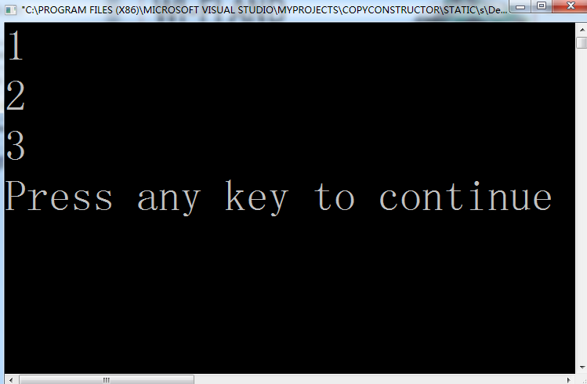
Static member variables
Static variables keep their values and are not destroyed even after they go out of scope.
#include <iostream>
using namespace std;
int generateID()
{
static int s_id = 0;
return ++s_id;
}
int main()
{
cout << generateID() << '\n';
cout << generateID() << '\n';
cout << generateID() << '\n';
return 0;
}

Slide 18
Static member variables
C++ introduces two more uses for the static keyword when applied to classes:
  static member variables
  static member functions

Slide 19
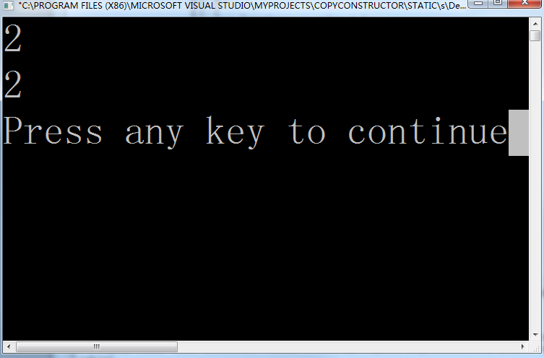
Static member variables
Member variables of a class can be made static by using the static keyword.
#include <iostream>
using namespace std;
class Something
{
public:
static int s_value;
};
int Something::s_value = 1;
int main()
{
Something first;
Something second;
second.s_value = 2;
cout << first.s_value << '\n';
cout << second.s_value << '\n';
return 0;
}
Because s_value is a static member variable, s_value is shared between all objects of the class. Consequently, first.s_value is the same variable as second.s_value.

Slide 20
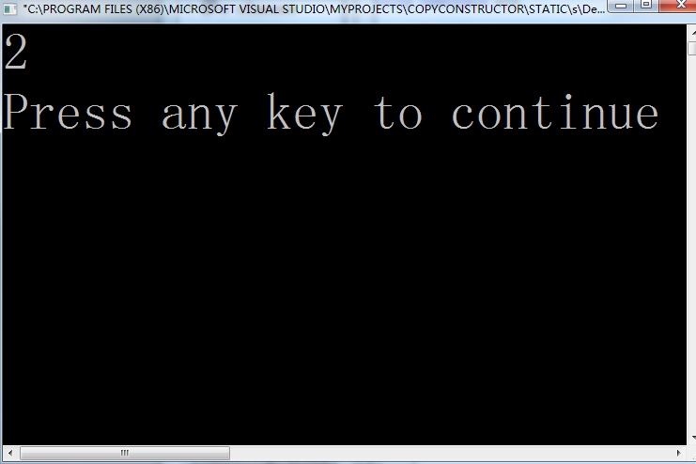
Static members are not associated with class objects
Although you can access static members through objects of the class it turns out that static members exist even if no objects of the class have been instantiated!
#include <iostream>
using namespace std;
class Something
{
public:
static int s_value; // declares the static member variable
};
int Something::s_value = 1; // defines the static member variable
int main()
{
// note: we're not instantiating any objects of type Something
Something::s_value = 2;
cout << Something::s_value <<endl;
return 0;
}

Slide 21
Defining and initializing static member variables
You must explicitly define the static member outside of the class, in the global scope.
int Something::s_value = 1; // defines the static member variable
This line serves two purposes:
  it instantiates the static member variable (just like a global variable)
  optionally initializes it
  (In this case, we’re providing the initialization value 1. If no initializer is provided, C++ initializes the value to 0.)
Notes:
When we declare a static member variable inside a class, we’re simply telling the class that a static member variable exists (much like a forward declaration). Because static member variables are not part of the individual class objects (they get initialized when the program starts), you must explicitly define the static member outside of the class, in the global scope.

Slide 22
Static member functions
C++ introduces two more uses for the static keyword when applied to classes:
  static member variables
  static member functions

Slide 23
Static member functions
class Something
{
private:
static int s_value;
};
int Something::s_value = 1; // this is okay even though s_value is private since it's a definition
int main()
{
// how do we access Something::s_value since it is private?
}
Notes:
In the previous lesson on static member variables, you learned that static member variables are member variables that belong to the class rather than objects of the class. If the static member variables are public, we can access them directly using the class name and the scope resolution operator. But what if the static member variables are private? Consider the following example:

Slide 24
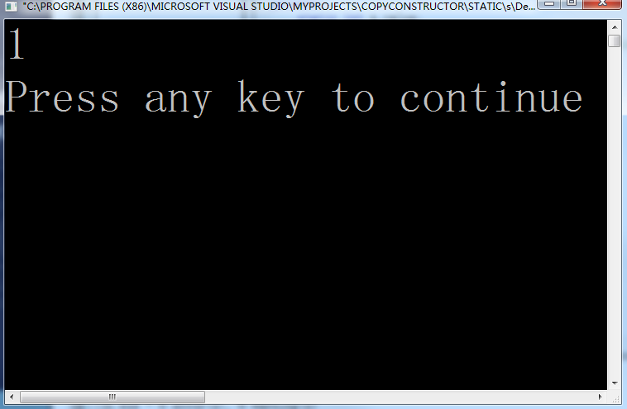
Static member functions
Like static member variables, static member functions are not attached to any particular object.
#include <iostream>
using namespace std;
class Something
{
private:
static int s_value;
public:
static int getValue() { return s_value; } // static member function
};
int Something::s_value = 1; // initializer
int main()
{
cout << Something::getValue() << '\n';
}
Notes:
Because static member functions are not attached to a particular object, they can be called directly by using the class name and the scope operator. Like static member variables, they can also be called through objects of the class type, though this is not recommended.

Slide 25
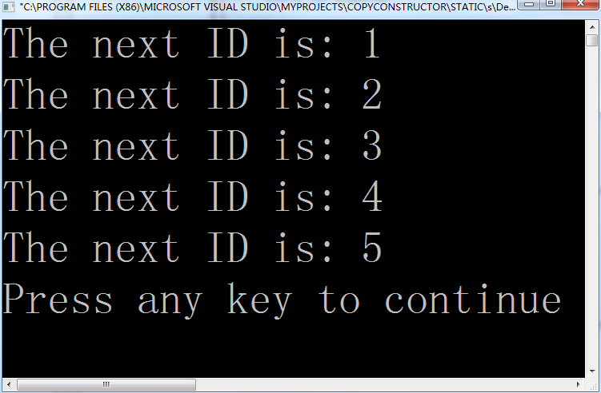
Example
#include <iostream>
using namespace std;
class IDGenerator
{
private:
static int s_nextID;
public:
static int getNextID();
};
// We'll start generating IDs at 1
int IDGenerator::s_nextID = 1;
// Here's the definition of getNextID() outside of the class. Note we don't need to use the static keyword here.
int IDGenerator::getNextID() { return s_nextID++; }
int main()
{
for (int count=0; count < 5; ++count)
cout << "The next ID is: " << IDGenerator::getNextID() << '\n';
return 0;
}

Slide 26
Static member functions have no *this pointer
Static member functions have two interesting quirks :
  First, because static member functions are not attached to an object, they have no this pointer!
    This makes sense when you think about it -- the this pointer always points to the object that the member function is working on. Static member functions do not work on an object, so the this pointer is not needed.
  Second, static member functions can only access static member variables. They can not access non-static member variables.
    This is because non-static member variables must belong to a class object, and static member functions have no class object to work with!
Notes:
你可以考虑一下，一个班内有50个学生，编号1~50。这是唯一的.
但是对一个校长来说，学号25对他来说是没意义的，除非加上班级的限制。
但是对每一个学生来说，校长是没有歧义的，唯一的。
static int sgetValue(Something &a) { a.w; } // static member function

Slide 27
see project-example
#include <iostream>
using namespace std;
class Something
{
private:
int non_s;
static int s_value;
public:
static int getValue() { return s_value; } // static member function
static int getNonSValue( Something &a) {
return a.non_s; } // static member function
};
int Something::s_value = 1; // initializer
int main()
{
cout << Something::getValue() << '\n';
Something a;
cout << Something::getNonSValue(a) << '\n';
}
Notes:
静态成员函数可以直接访问该类的静态数据和函数成员，而访问非静态数据成员必须通过参数传递的方式得到一个对象名，然后通过对象名来访问。

Slide 28
Example
#include "iostream"
using namespace std;
class test
{
private:
int x;
int y;
public:
static int num;
static int Getnum()
{
x+=5; // ?
num+=15;
return num;
}
};
int test::num = 10;
int main(void)
{
test a;
cout<<test::num<<endl;
test::num = 20;
cout<<test::num<<endl;
cout<<test::Getnum()<<endl;
cout<<a.Getnum()<<endl;
system("pause");
return 0;
}
//10
//20
//35
//50
Error
Notes:
通过上例可知： x+=5; // 这行代码是错误的
静态函数成员必须通过对象名来访问非静态数据成员。
另外，静态成员函数在类外实现时候无须加static关键字，否则是错误的。
1、static成员的所有者是类本身和对象，但是多有对象拥有一样的静态成员。从而在定义对象是不能通过构造函数对其进行初始化。
2、静态成员不能在类定义里边初始化，只能在class body外初始化。
3、静态成员仍然遵循public，private，protected访问准则。
4、静态成员函数没有this指针，它不能返回非静态成员，因为除了对象会调用它外，类本身也可以调用。

Slide 29
Summary
Persistence: it remains in memory until the end of the program.
File scope: it can be seen only within a file where it's defined.
Visibility: if it is defined within a function/block, it's scope is limited to the function/block. It cannot be accessed outside of the function/block.
Class: static members exist as members of the class rather than as an instance in each object of the class. So, this keyword is not available in a static member function. Such functions may access only static data members.
A static data member : class variable
A non-static data member : instance variable
Static member function: it can only access static member data, or other static member functions while non-static member functions can access all data members of the class: static and non-static.
Notes:
你可以考虑一下，一个班内有50个学生，编号1~50。这是唯一的.
但是对一个校长来说，学号25对他来说是没意义的，除非加上班级的限制。
但是对每一个学生来说，校长是没有歧义的，唯一的。
static int sgetValue(Something &a) { a.w; } // static member function

Slide 30
Const class objects and member functions
Const classes
  Instantiated class objects can also be made const by using the const keyword. Initialization is done via class constructors
const Date date1; // initialize using default constructor
const Date date2(2020, 10, 16);
// initialize using parameterized constructor
Once a const class object has been initialized via constructor, any attempt to modify the member variables of the object is disallowed, as it would violate the const-ness of the object. This includes both changing member variables directly (if they are public), or calling member functions that set the value of member variables.

Slide 31
Example
class Something
{
public:
int m_value;
Something(): m_value(0) { }
void setValue(int value) { m_value = value; }
int getValue() { return m_value ; }
};
int main()
{
const Something something; // calls default constructor
something.m_nValue = 5; // compiler error: violates const
something.setValue(5); // compiler error: violates const
return 0;
}
Notes:
Both of the above lines involving variable something are illegal because they violate the constness of something by either attempting to change a member variable directly, or calling a member function that attempts to change a member variable.

Slide 32
Const member functions
cout << something.getValue();
This will also cause a compiler error, even though getValue() doesn’t do anything to change a member variable!
It turns out that const class objects can only explicitly call const member functions
  getValue() has not been marked as a const member function
A const member function is a member function that guarantees it will not change any class variables or call any non-const member functions.

Slide 33
Const member functions
How to make getValue() a const member function?
  Simply append the const keyword to the function prototype, after the parameter list, but before the function body
class Something
{
public:
int m_value;
Something() { m_value= 0; }
void resetValue() { m_value = 0; }
void setValue(int value) { m_value = value; }
int getValue() const { return m_value; }
// note addition of const keyword after parameter list, but before function body
};
Notes:
Now getValue() has been made a const member function, which means we can call it on any const objects.

Slide 34
Const member functions
For member functions defined outside of the class declaration, the const keyword must be used on both the function prototype in the class declaration and on the function definition:
class Something{
public:
int m_value;
Something() { m_value= 0; }
void resetValue() { m_value = 0; }
void setValue(int value) { m_value = value; }
int getValue() const; // note addition of const keyword here
};
int Something::getValue() const //member function defined outside of the class declaration
{
return m_value;
}

Slide 35
Const member functions
Any const member function that attempts to change a member variable or call a non-const member function will cause a compiler error to occur.
  class Something
  {
  public:
  int m_value ;
  void resetValue() const { m_value = 0; }
  // compile error, const functions can't change member variables.
  };
  Note that constructors should not be marked as const. This is because const objects need to be able to initialize their member variables, and a const constructor would not be able to do so.
Notes:
In this example, resetValue() has been marked as a const member function, but it attempts to change m_value. This will cause a compiler error.

Slide 36
Const references
Although instantiating const class objects is one way to create const objects, a more common way is by passing a class argument by value causes a copy of the class to be made (which is slow) -- most of the time, we don’t need a copy, a reference to the original argument works just fine, and is more performant because it avoids the needless copy.
We typically make the reference const in order to ensure the function does not inadvertently change the argument, and to allow the function to work with R-values (e.g. literals), which can be passed as const references, but not non-const references.

Slide 37
what’s wrong with the following code?
#include <iostream>
using namespace std;
class Date {
private:
int m_year;
int m_month;
int m_day;
public:
Date(int year, int month, int day) {
setDate(year, month, day);
}
void setDate(int year, int month, int day{
m_year = year;
m_month = month;
m_day = day;
}
int getYear() { return m_year; }
int getMonth() { return m_month; }
int getDay() { return m_day; }
};
/* note: We're passing date by const reference here to avoid making a copy of date*/
void printDate(const Date &date)
{
cout << date.getYear() << "/" << date.getMonth() << "/" << date.getDay() << '\n';
}
};
int main()
{
Date date(2016, 10, 16);
printDate(date);
return 0;
}
we can’t call non-const member functions on const objects
Notes:
The answer is that inside of the printDate function, date is treated as a const object. And with that const date, we’re calling functions getYear(), getMonth(), and getDay(), which are all non-const. Since we can’t call non-const member functions on const objects, this will cause a compile error.

Slide 38
The fix is simple: make getYear(), getMonth(), and getDay() const
  public:
  Date(int year, int month, int day) {
  setDate(year, month, day);
  }
  // setDate() cannot be const, modifies member variables
  void setDate(int year, int month, int day)
  {
  m_year = year;
  m_month = month;
  m_day = day;
  }
  // The following getters can all be made const
  int getYear() const { return m_year; }
  int getMonth() const { return m_month; }
  int getDay() const { return m_day; }
  };

Slide 39
friend Functions and friend Classes
friend declarations
  friend function
    Keyword friend before function prototype in class that is giving friendship.
    friend int myFunction( int x );
    Appears in the class granting friendship
  friend class
    Type friend before class Classname in class granting friendship
    If ClassOne granting friendship to ClassTwo,
  friend class ClassTwo;
  appears in ClassOne's definition

Slide 40
Friend functions
    class Accumulator{
    private:
    int m_value;
    public:
    Accumulator() { m_value = 0; }
    void add(int value) { m_value += value; }
    // Make the reset() function a friend of this class
    friend void reset(Accumulator &accumulator);
    };
    // reset() is now a friend of the Accumulator class
    void reset(Accumulator &accumulator){
    // And can access the private data of Accumulator objects
    accumulator.m_value = 0;
    }

Slide 41
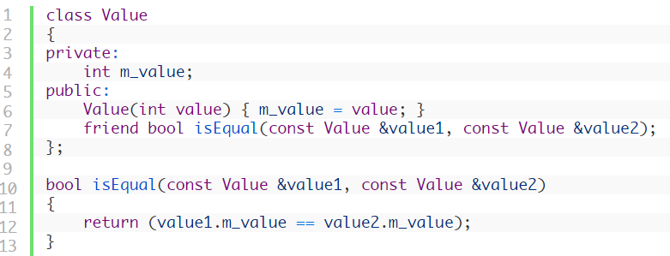
Example
Notes:
In this example, we declare the isEqual() function to be a friend of the Value class. isEqual() takes two Value objects as parameters. Because isEqual() is a friend of the Value class, it can access the private members of all Value objects. In this case, it uses that access to do a comparison on the two objects, and returns true if they are equal.

Slide 42
Friend classes
It is also possible to make an entire class a friend of another class. This gives all of the members of the friend class access to the private members of the other class.

Slide 43
friend
#include<iostream>
using namespace std;
class A{
private: int x;
Public: A(){x=1;}
};
class B{
Private: char c;
Public: B() {c='c';}
void something(){
A instance;
cout<<instance.x<<endl;
}
};
int main(){
B b_instance;
b_instance.something();
return 0;
}
friend class B;

Slide 44
Friend member functions
Instead of making an entire class a friend, you can make a single member function a friend.
This is done similarly to making a normal function a friend, except using the name of the member function with the className:: prefix included
(e.g. Display::displayItem).
However, in actuality, this can be a little trickier than expected.
Let’s convert the previous example to make Display::displayItem a friend member function. You might try something like this:

Slide 45
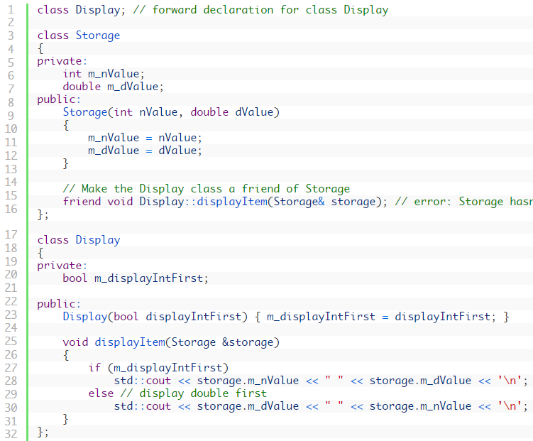
Notes:
error: Storage hasn't see the full declaration of class Display. it turns out this won’t work. In order to make a member function a friend, the compiler has to have seen the full declaration for the class of the friend member function (not just a forward declaration). Since class Storage hasn’t seen the full declaration for class Display yet, the compiler will error at the point where we try to make the member function a friend.

Slide 46
Amendment
To resolve this, we can switch the order of class Display and class Storage.
To move the definition of Display::displayItem() out of the Display class declaration, because it needs to have seen the definition of class Storage first.

Slide 47
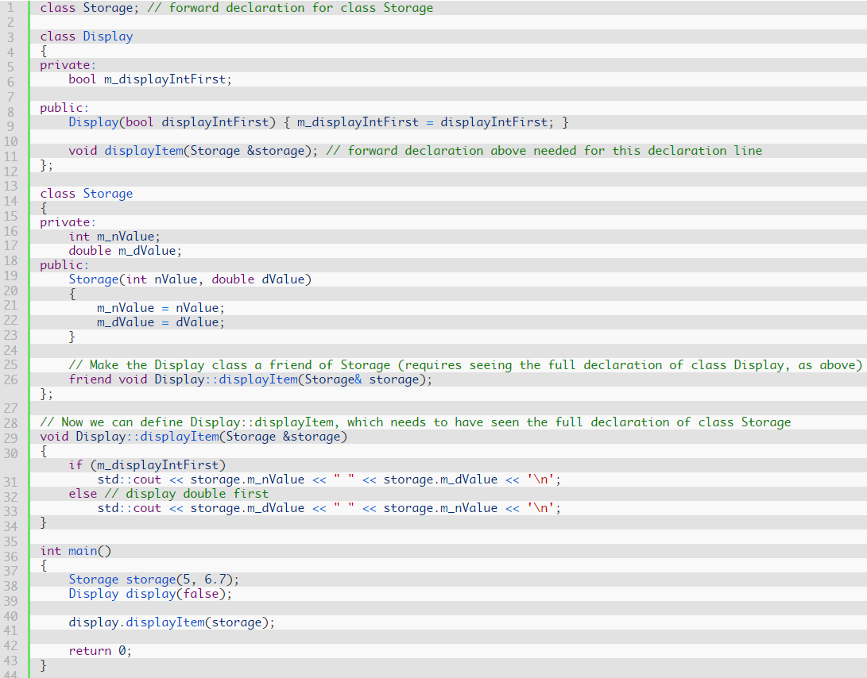


Slide 48
friend Functions and friend Classes
friend function and friend classes
  Can access private and protected (more later) members of another class
  friend functions are not member functions of class
    Defined outside of class scope
Properties
  Friendship is granted, not taken
  NOT symmetric (if B a friend of A, A not necessarily a friend of B)
  NOT transitive (if A a friend of B, B a friend of C, A not necessarily a friend of C)

Slide 49
More about ‘Friend’
The major use of friends is
  to provide more efficient access to data members than the function call
  to accommodate operator functions with easy access to private data members
Friends can have access to everything, which defeats data hiding, so use them carefully
Friends have permission to change the internal state from outside the class. Always recommend use member functions instead of friends to change state

